Slide 1
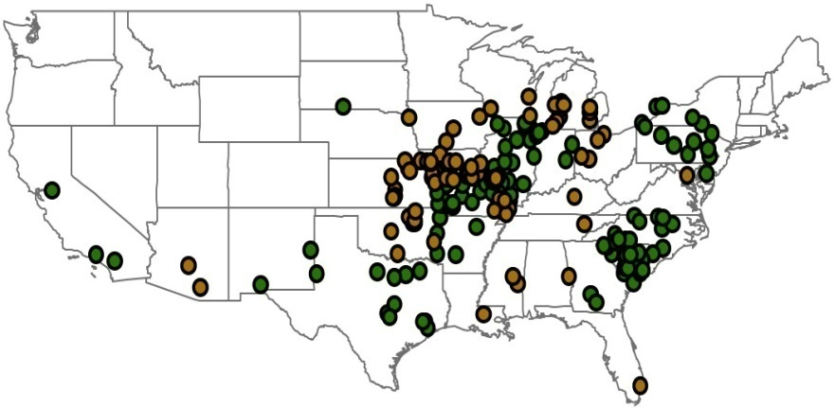
Are School Wellness Policies Associated with Weight
and Related Behaviors Among Post Partum Teens?
Debra Haire-Joshu, PhD, Michael Elliott, PhD, Rebecca Schermbeck, MPH, MS, RD, Cindy Schwarz, MPH, MS, RD
Contact: Debra Haire-Joshu at 314-362-9554, djoshu@gwbmail.wustl.edu
Center for Obesity Prevention and Policy Research, George Warren Brown School of Social Work and Department of Internal Medicine, Washington University, St. Louis, MO
Background and Methods
Results
Background
The quality of the food and activity environment may impact the ability to make or sustain behavior changes. The Child Nutrition and WIC Reauthorization Act of 2004 required that all school districts with federally-funded school meals develop and implement school wellness policies (SWP). SWPs vary in content and strength. Little is known about the impact of these SWPs on weight reduction interventions.
BALANCE (Balance Adolescent Lifestyle Activities and Nutrition Choices for Energy) is a group randomized obesity prevention intervention delivered through Parents As Teachers at home, school, and via internet website
960 postpartum teens across 22 states
Primary outcome: decrease in postpartum weight retention
Intermediate outcomes : replace sweet drinks, high fat snacks excess portion size,
and sedentary activity with water intake, fruit and vegetable intake,
recommended portion size and walking.
Purpose
(1) To describe the quality of SWPs of schools participating in a randomized weight reduction trial for teens;
(2) To determine if SWPs are associated with the effectiveness of the BALANCE intervention.
Methods
We collected and evaluated SWPs from the 335 school districts of randomized to the BALANCE intervention and analyzed relationship between SWP quality and pre-post change in postpartum teens.
.
Mean SWP Quality Score
Policy Area | Score type | MN (SD) | Policy Area | Score type | MN (SD)
Total score | Comp. | 39 (19) | Physical education | Comp. | 32 (23)
 | Strength | 19 (12) |  | Strength | 17 (14)
Nutrition education | Comp. | 47 (28) | Physical activity | Comp. | 38 (27)
 | Strength | 29 (21) |  | Strength | 22 (18)
USDA school meal standards | Comp. | 40 (24) | Communication and promotion | Comp. | 39 (25)
 | Strength | 24 (17) |  | Strength | 20 (18)
Competitive foods standards | Comp. | 38 (20) | Evaluation | Comp. | 56 (27)
 | Strength | 10 (15) |  | Strength | 30 (25)
Correlations of SWP with BALANCE Pre-Post Outcomes Among Postpartum Teens
Policy Area | Score type | BMI % Change | Total Cal. | Oz Water | Cal. Sugar Bev. | Cal. Snacks | Cal. Fruit & Veg. | Min. Walking
District policy total | Comp. | .035 | -.073 | -.073 | .030 | -.067 | .132 | -.076
 | Strength | .101 | -.053 | -.053 | .065 | -.039 | .078 | -.062
Nutrition education | Comp. | -.007 | -.091 | -.064 | -.014 | -.080 | .159* | -.029
 | Strength | .046 | -.053 | -.054 | -.014 | -.054 | .118 | -.019
USDA school meal standards | Comp. | .032 | .000 | -.158* | .094 | .020 | .107 | -.081
 | Strength | .030 | -.005 | -.112 | .132 | -.022 | .060 | -.044
Competitive foods standards | Comp. | .071 | -.177* | -.066 | -.073 | -.121 | .017 | -.075
 | Strength | .155 | -.170* | .001 | -.017 | -.082 | -.028 | -.047
Physical education | Comp. | -.003 | -.033 | -.146 | .067 | -.079 | .170* | -.108
 | Strength | .040 | -.005 | -.132 | .019 | -.048 | .151 | -.061
Physical activity | Comp. | -.008 | .002 | -.088 | .084 | -.043 | .130 | -.054
 | Strength | .046 | -.006 | -.119 | .149 | -.039 | .080 | -.118
Communication and promotion | Comp. | .041 | -.019 | -.060 | .038 | -.015 | .153* | -.022
 | Strength | .050 | .042 | -.089 | .050 | .059 | .053 | .013
Evaluation | Comp. | .050 | .014 | -.091 | .079 | .003 | .092 | -.025
 | Strength | .083 | .079 | -.099 | .115 | .039 | .095 | -.052
SWP Measures
SWP Evaluation Tool
A 96 item coding system by Schwartz et al (2009) yielded a total policy score (0% to 100%) and sub scores for comprehensiveness and strength.
Teen Measures
Height and Weight
2. Beverage and Snack Food Frequency Questionnaire (R=0.67)
31 items measuring:
Total calories from snacks and beverages
Total ounces of water
Calories from sugary beverages
Calories from snack foods
Calories from fruits and vegetables
3. 3-Day Self-Administered Physical Activity Questionnaire
(R=.50)
Descriptive Parameters (N=960)
Age | MN = 17.6 (SD 1.3)
BMI% | MN=80.86 (SD 18.9)
BMI % Change | MN=10.0 (SD 17.4)
Overweight/Obese | 49.5%
White Black Hispanic | 50.3% 28.1% 18.9%
Daily calories from snacks and beverages | MN = 1656 (SD 1067)
Daily minutes walking | MN = 29 (SD 40)
*Correlation is significant at the 0.05 level (2-tailed)
Conclusions and Policy Implications
z
SWPs are generally weak (total comp. 39% and strength 19%) ; evaluation area has highest scores ; lowest comp. score was physical education (32%) ; lowest strength score was competitive food standards (10%). Despite low scores, competitive foods standards were related to reduced total calories; comp .score in nutrition education, physical education, and communication were related to improved FV consumption.
Policy Implications
Improvements in SWP language is needed and may enhance the impact of specific energy balance behaviors. SWPs appear to influence the environment and impact of energy balance interventions.
Funded by: National Cancer Institute of the National Institutes of Health

